Slide 1
BUSINESS INTELLIGENCE
Review -3
Kavin AK | 19BAI1102
Dhaxina Kumar | 19BAI1058
Bharathwaj Murali | 19BAI1137

Slide 2
INTRODUCTION
Brain tumor is one among the foremost rigorous diseases in life science. An efficient and efficient analysis is usually a key concern for the radiologist within the premature phase of tumor growth. Histological grading, supported by a stereotactic biopsy test, is the gold standard and also the convention for detecting the grade of a tumor. The biopsy procedure requires the neurosurgeon to drill a tiny low hole into the skull from which the tissue is collected. Many risk factors must be taken into consideration during a biopsy test, this including bleeding of the brain tumor which may cause infection, seizures, stroke, coma and even death. But the most concern with the stereotactic biopsy is that it's not 100% accurate which can lead to a significant diagnostic error followed by a wrong clinical management of the disease. Also, If the computerized approach is made robust when detecting tumors in the brain, it will be of great help to many doctors as it frees them from manually detecting tumors as the human error should also be taken into account when done manually.

Slide 3
OBJECTIVES
Early detection of the tumor in the brain before it aggravates using the detection model plays a crucial role in improvising the treatment of the tumor which helps in improving the health condition of the patients.
This type of model is necessary in hospitals due to a fewer number of skilled doctors who can attend to this issue. Medical imaging helps the model in training as a visual representation is given to the model in order to understand what the image is about.
One of the most efficient methods towards an image is segmentation. Precise segmentation of the tissues will help in the diagnosis of the tumor within the brain and this will help the doctors in planning the treatment.

Slide 4
Dataset
A brain tumor is a collection, or mass, of abnormal cells in your brain. MRI uses a powerful magnetic field, radiofrequency pulses, and a computer to produce detailed pictures of internal body structures including brain and spinal cord.
The image data that was used for this problem is Brain MRI Images for Brain Tumor Detection. It consists of MRI scans of two classes:
●NO - no tumor, encoded as 0
●YES - tumor, encoded as 1
Unfortunately, the dataset description doesn't hold any information where this MRI scans come from and so on.

Slide 5
METHODOLOGIES
Here we train the model with different Machine Learning Algorithms to get different accuracies and compare them to figure out the best accuracy:
VGG16
Resnet50
InceptionV3

Slide 6
Proposed System
●Importing modules and arranging directories
●Data import and preprocessing
●Transfer Learning using VGG16
●Data augmentation
●Model building
●Model Performance

Slide 7
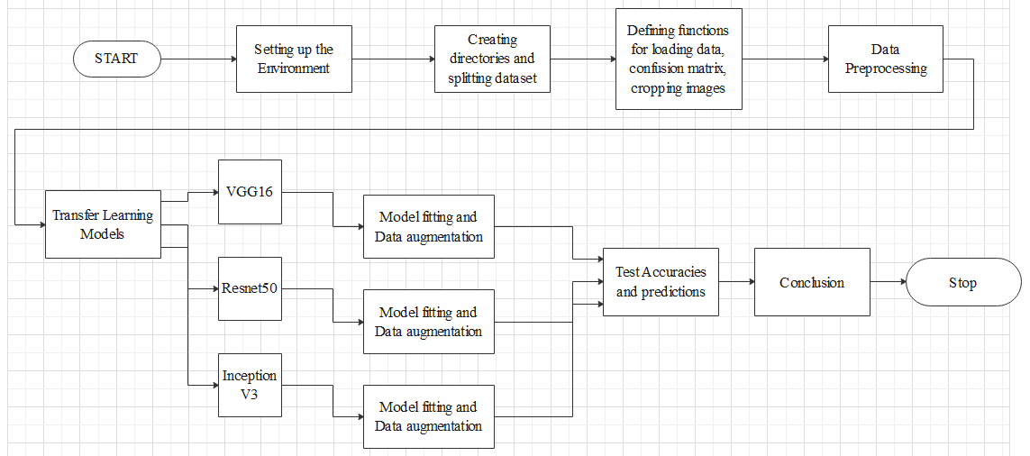
Model Diagram (Architecture)

Slide 8
Results
After model fitting the Accuracy score is better than other models for RESNET50 because, ResNet improves the efficiency of deep neural networks with more neural layers while minimizing the percentage of errors. In other words, the skip connections which are add to the outputs from the previous layers towards the outputs of stacked layers, making it possible and easier to train much deeper and powerful networks than previously possible.

Slide 9
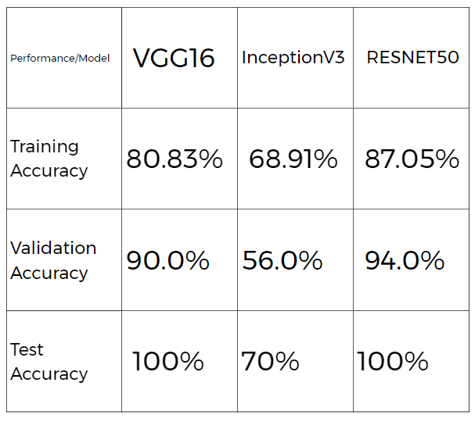
Results

Slide 10
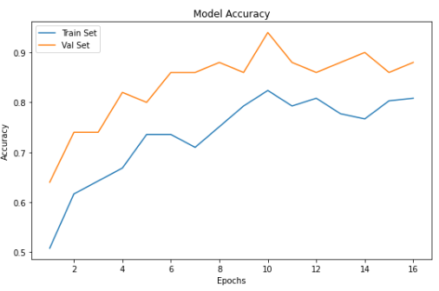
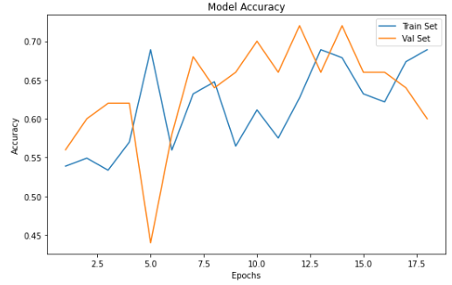
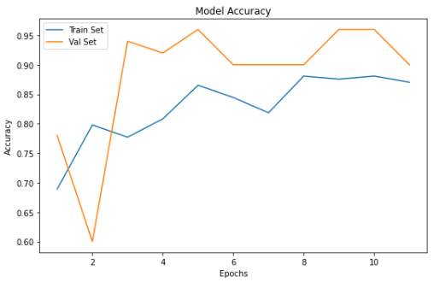
Graphs
VGG 16
Inceptionv3
Resnet50

Slide 11
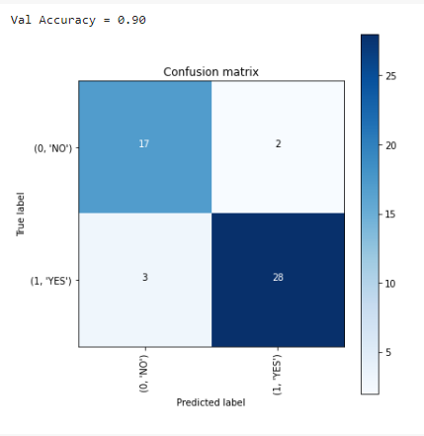
VGG 16 Confusion Matrix

Slide 12
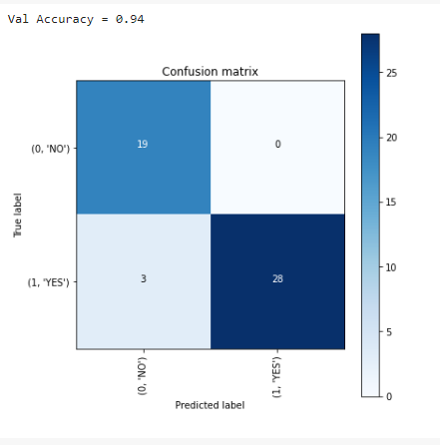
ResNet 50 Confusion Matrix

Slide 13
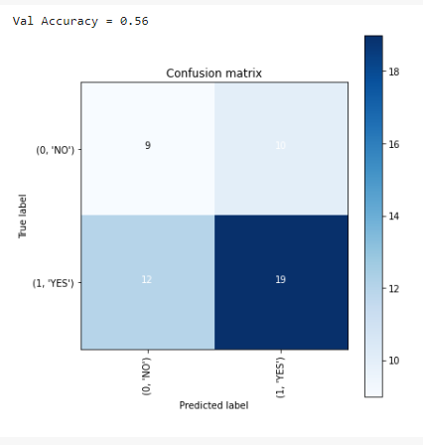
Inception V3 Confusion Matrix

Slide 14
References
https://iopscience.iop.org/article/10.1088/1757-899X/1055/1/012115
https://www.hindawi.com/journals/jhe/2022/2693621/
https://arxiv.org/abs/2101.00216
https://papers.ssrn.com/sol3/papers.cfm?abstract_id=3867216
https://www.sciencedirect.com/science/article/pii/S1877050920306542
https://www.frontiersin.org/articles/10.3389/fncom.2019.00083/full

